Slide 1

Food Delivery Management System
Course Project - Database Systems
Team Members:
KRISHNA TRIPATHY 23BCE0174
AMAN ARYAN 23BCE0770
ADITYA SINHA 23BCE0928

Slide 2
Abstract
This project focuses on designing and implementing a robust database-driven Food Delivery Management System using SQL*Plus. The system is engineered to efficiently manage critical aspects such as customer orders, restaurant menus, delivery assignments, and secure payment processing.
Key features include real-time order tracking, comprehensive performance monitoring, and detailed sales reporting. The project extensively utilizes advanced SQL capabilities, including complex queries, optimized views, sophisticated stored procedures, and automated triggers.

Slide 3

Introduction
Market Need
Technical Challenge
Our Solution
Food delivery platforms have evolved from convenience services into essential components of daily urban life
Swift and accurate meal delivery necessitates highly robust and scalable backend systems
Comprehensive database solution streamlining the entire process from order placement to delivery

Slide 4




Literature Survey: Database Foundations
Existing large-scale food delivery systems like Swiggy, Zomato, and Uber Eats rely on intricate database structures handling massive concurrent transactions. Our research reveals critical principles for operational efficiency:
Data Normalization
Triggers & Stored Procedures
Minimizing redundancy and improving data integrity for efficient storage and retrieval operations
Automating complex business logic and enhancing performance by reducing network round trips
Indexed Queries
Role-Based Access Control
Optimizing query performance for systems dealing with high read/write loads and concurrent access
Enforcing robust data security ensuring users access only information relevant to their roles

Slide 5

The Research Gap
The Problem
While commercial food delivery giants boast sophisticated, large-scale database operations, there's a notable scarcity of simplified, academic-level implementations. These often fail to demonstrate complete SQL-based backend solutions without external application dependencies.
Our Contribution
This project addresses this gap by providing a fully functional, SQL-only food delivery system that serves as a comprehensive educational tool and viable model for small-scale business applications.

Slide 6


Proposed System Architecture
1
2
Database Design
Core Modules
Comprehensive schema including Customers, Restaurants, Menu_Items, Orders, Order_Details, Delivery_Agents, Deliveries, and Payments tables with proper relationships and constraints
Customer order placement system, menu and restaurant management interface, delivery assignment and tracking mechanisms, and secure payment processing workflows
3
4
PL/SQL Automation
Reporting & Analytics
Automatic order status updates, intelligent auto-assignment of delivery agents based on location and availability, and real-time stock management with low inventory alerts
Detailed sales performance reports, delivery efficiency analytics, customer behavior insights, and identification of popular menu items with trend analysis

Slide 7
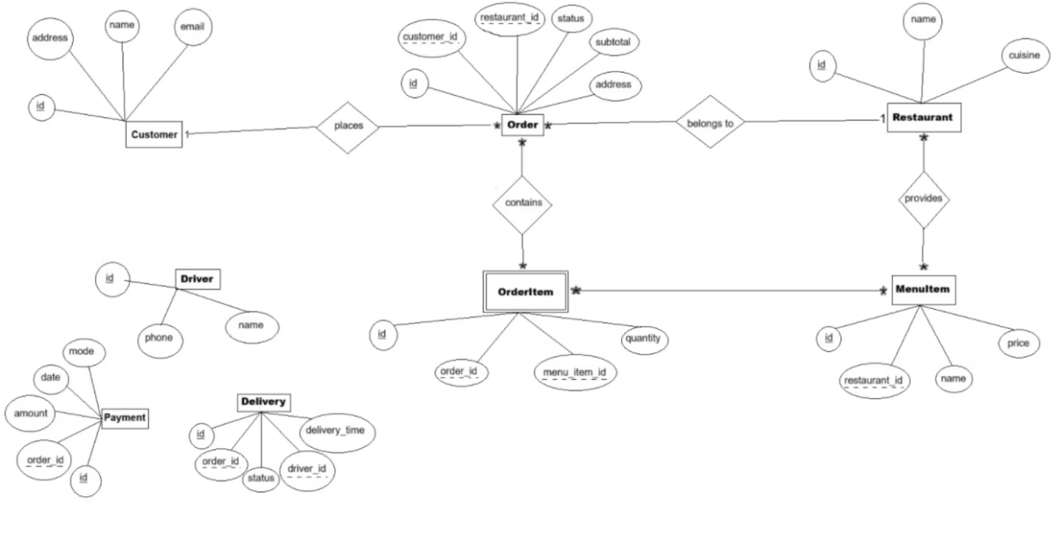
Entity Relationship Diagram
The ER diagram illustrates the comprehensive database schema with eight core entities and their relationships, ensuring data integrity through proper normalization and foreign key constraints.
Key relationships include one-to-many connections between Restaurants and Menu_Items, Customers and Orders, and Orders and Order_Details, with many-to-many relationships managed through junction tables.

Slide 8
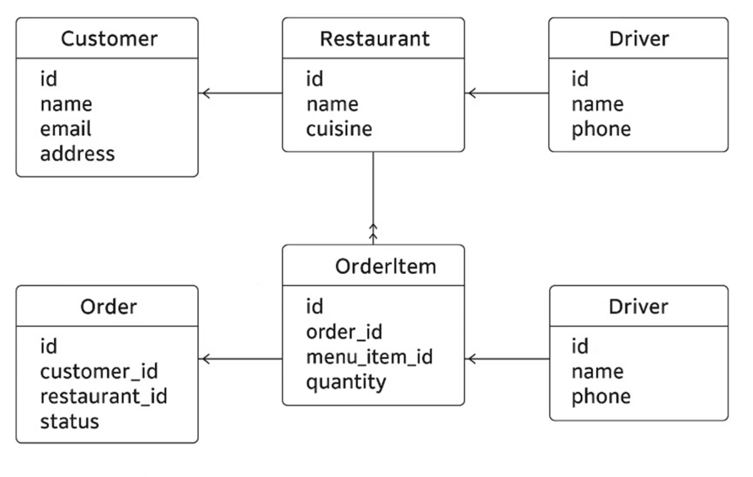
Schema Structure

Slide 9





Expected Outputs and Deliverables
Functional Database
Complete SQL*Plus database with representative sample data demonstrating operational integrity and real-world scenarios
Query Suite
Comprehensive SQL queries for menu searching, real-time order tracking, and automated generation of operational reports
Automation Tools
Robust triggers and stored procedures for delivery agent assignment and dynamic inventory management
Analytics Reports
Performance insights including sales analysis, popular items identification, and delivery efficiency metrics

Slide 10
The Customer Experience
The Goal: An Intuitive and Efficient User Journey
Our platform is designed to make the food ordering process simple and transparent for the customer. We focus on a clean, intuitive interface that guides them from discovery to delivery with minimal friction.
Effortless Discovery: The Home Screen features a prominent search bar and smart filters (cuisine, diet) so users can quickly find exactly what they're craving. Carousels for popular and featured restaurants highlight new options and deals.
Transparent Decision-Making: On the Restaurant Page, customers see detailed menus with high-quality images and clear pricing. Crucially, we include a Ratings & Reviews section to build trust and help them choose with confidence.
Seamless Checkout & Tracking: The Shopping Cart is always visible and easy to manage. Once an order is placed, our Order Tracking feature gives customers peace of mind with real-time status updates ("Preparing," "Out for Delivery") and a live map view of their driver's location.

Slide 11
The Restaurant Dashboard
The Goal: Streamlining Operations and Boosting Sales
We provide restaurants with a powerful, easy-to-use dashboard to manage their business, from handling orders to updating their menu. This is more than a simple app; it’s a backend control center.
Dynamic Order Management: The Order Management section is the heart of the dashboard. It separates incoming New Orders from Live Orders, giving staff a clear workflow. They can accept or reject new orders with a single click, and update statuses to keep customers and drivers in the loop.
Menu and Inventory Control: The Menu Management tool is designed for speed. Restaurants can instantly add or edit dishes and, most importantly, use a simple Availability Toggle to mark items as "in stock" or "out of stock" in real time. This prevents frustrating order cancellations for customers.
Data-Driven Insights: The Dashboard & Analytics section provides key business intelligence. Restaurants can view a Sales Overview and see their Top-Selling Items. This data helps them understand customer preferences and optimize their menu for higher profits.

Slide 12
The Delivery Driver Dashboard
The Goal: Maximizing Efficiency and Earnings
Our driver app is designed to be simple, efficient, and reliable. Every feature is built to help drivers complete deliveries faster and smarter, which directly impacts their earnings.
Clear Assignment Flow: When a new delivery request comes in, the driver receives a clear notification showing the pickup location, customer address, and estimated earnings. This allows them to quickly decide whether to accept the job.
Integrated Navigation: For accepted jobs, the Navigation feature links directly to a mapping service, providing turn-by-turn directions to both the restaurant and the customer. This minimizes wasted time and helps ensure on-time deliveries.
Simplified Communication & Updates: The app includes quick Contact Options to call or message the customer or restaurant. Status updates are handled with simple, clear buttons ("Picked Up," "Delivered"), ensuring accurate real-time tracking for all parties. Drivers can also easily view their Earnings & History to keep track of their performance and income.

Slide 13
Comparison and Observations
Our database implementation demonstrates significant improvements in normalization, referential integrity, and data accuracy compared to the reference paper's approach.
Observation
Reference Paper
Our Findings
Normalization
Up to 2NF (some duplication tolerated for simplicity)
Achieved 3NF/BCNF — every attribute depends only on its key; no redundancy between order_items, customers, restaurants
Referential Integrity
Suggested use of foreign keys but not implemented/tested
Actively enforced through FOREIGN KEY constraints (order_items → orders, orders → customers, orders → restaurants, orders → delivery_agents)
Data Accuracy
Possible orphaned records in example schema
No orphan records — enforced referential integrity ensured 100% consistency
These improvements ensure a more robust, maintainable, and reliable database architecture for production environments.

Slide 14
Website Demo Screenshots

Slide 15
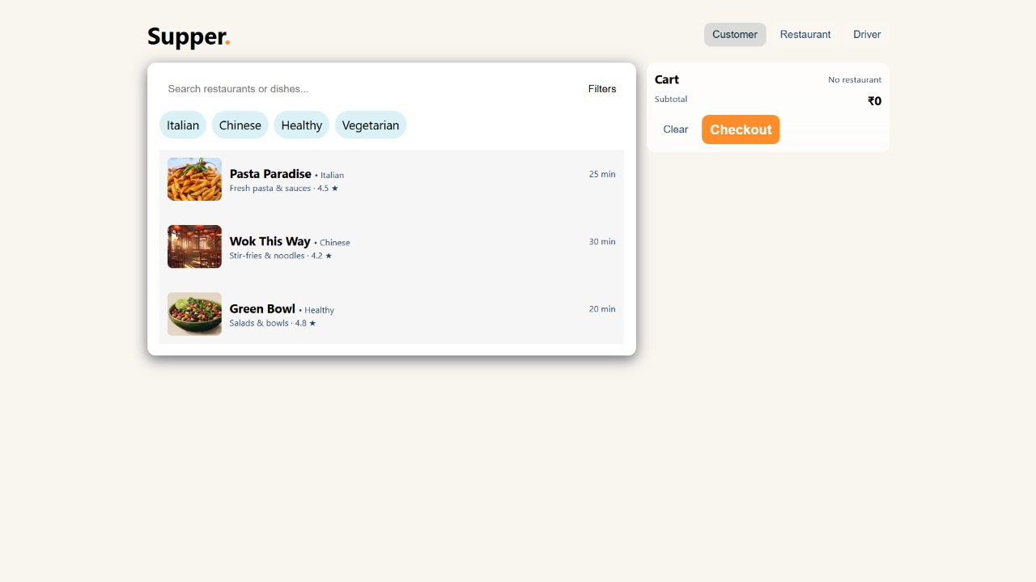

Slide 16
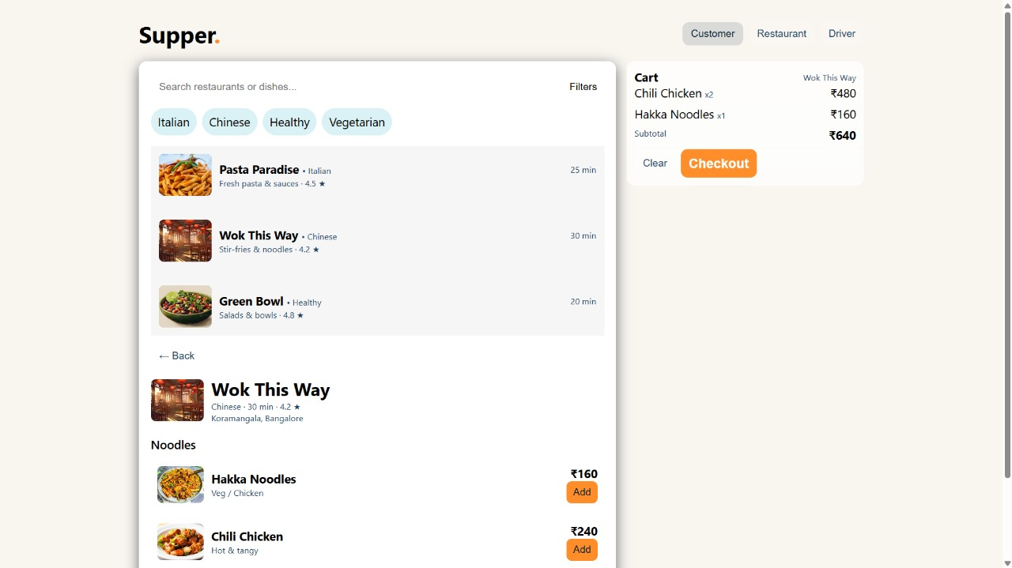

Slide 17
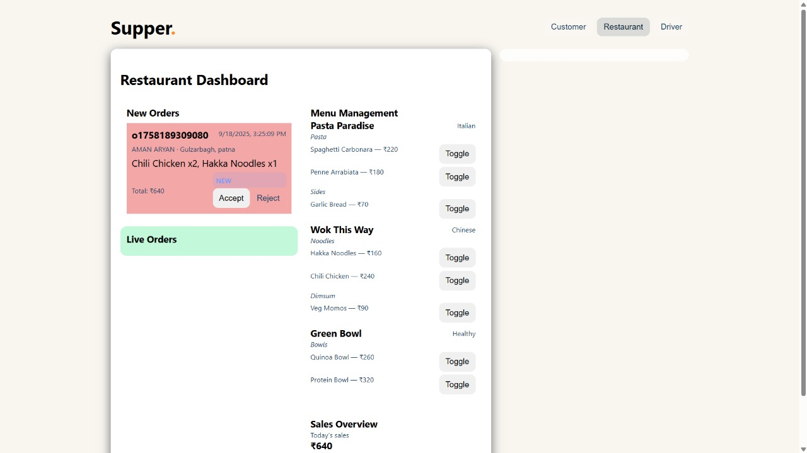

Slide 18
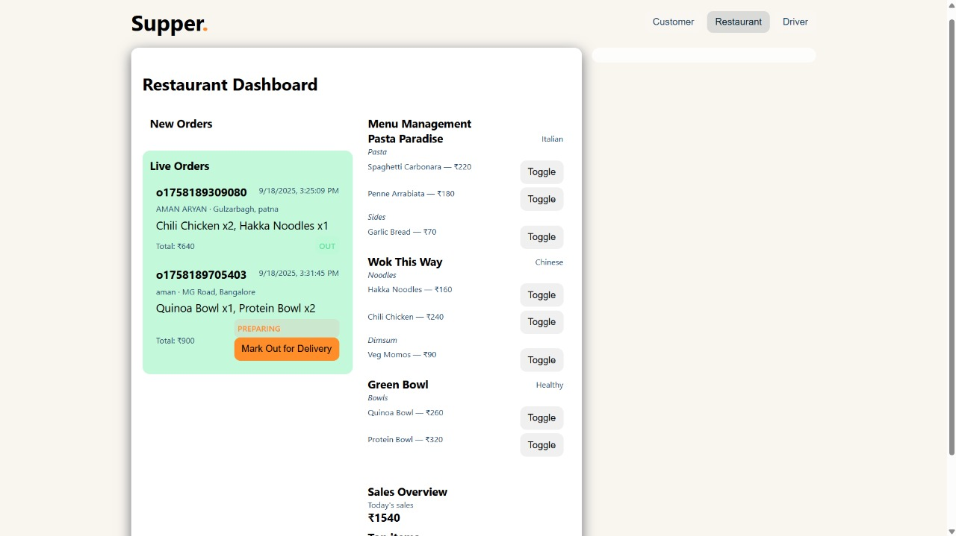

Slide 19
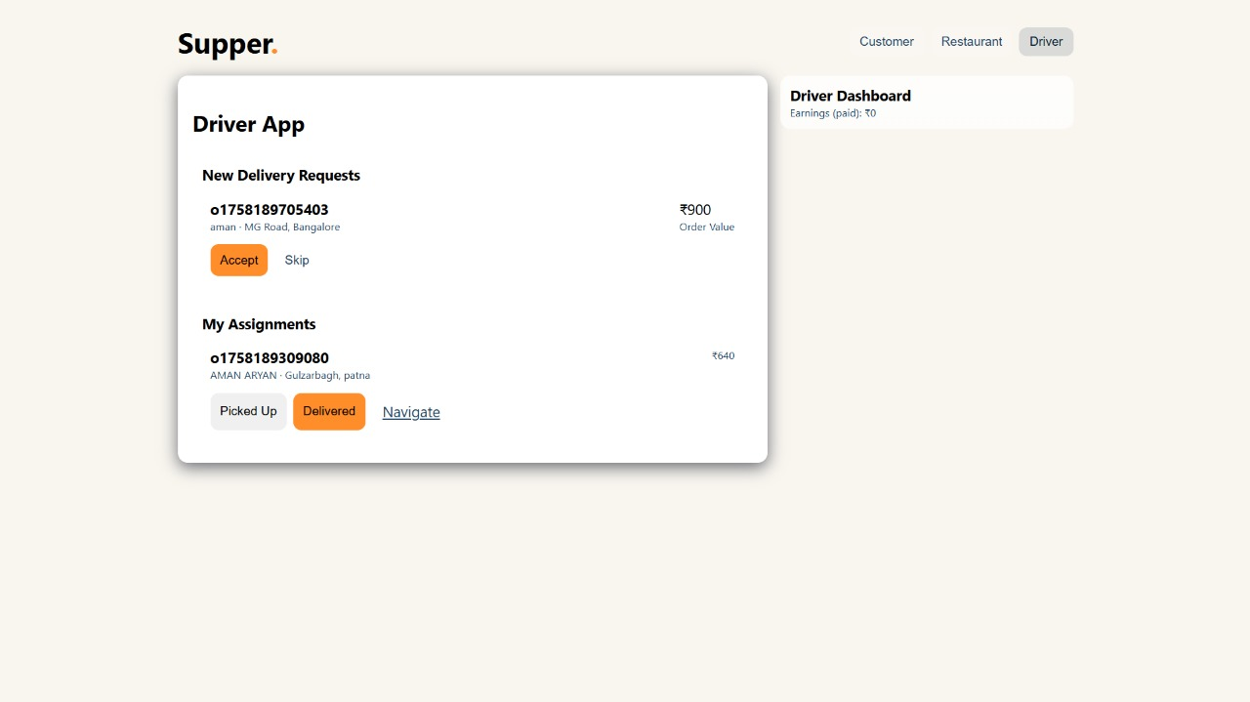

Slide 20
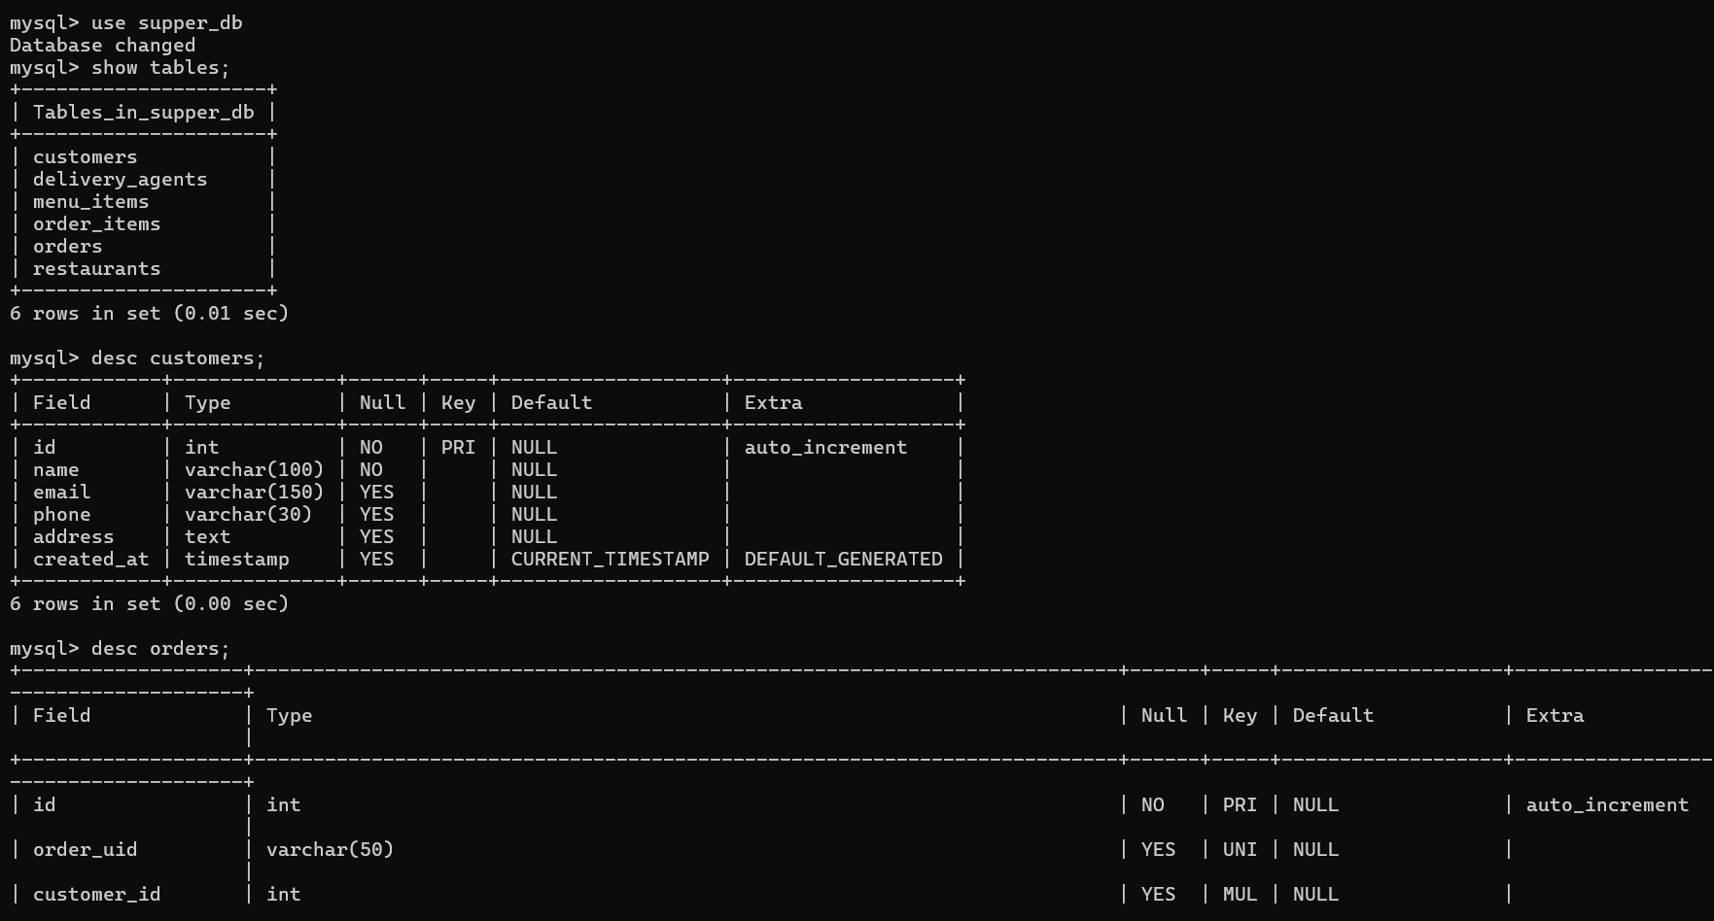

Slide 21
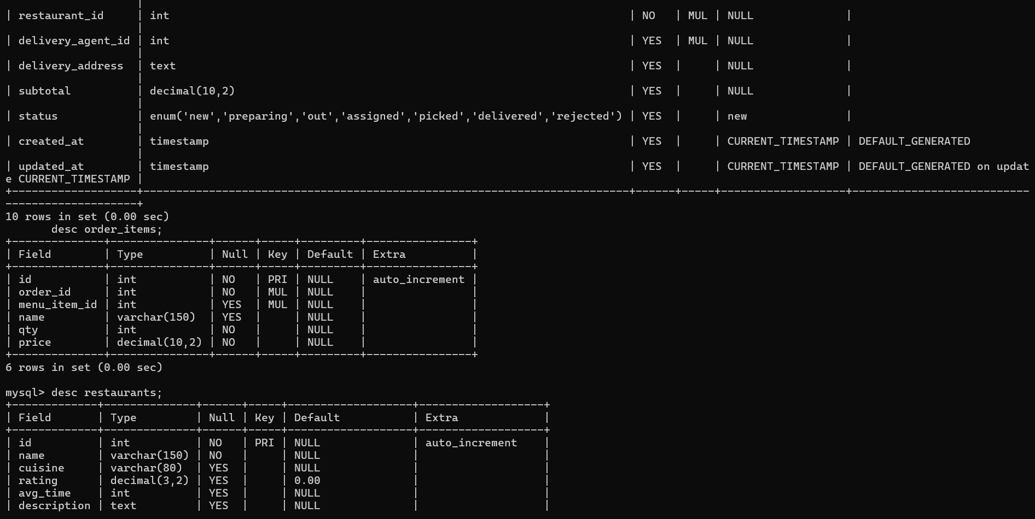

Slide 22
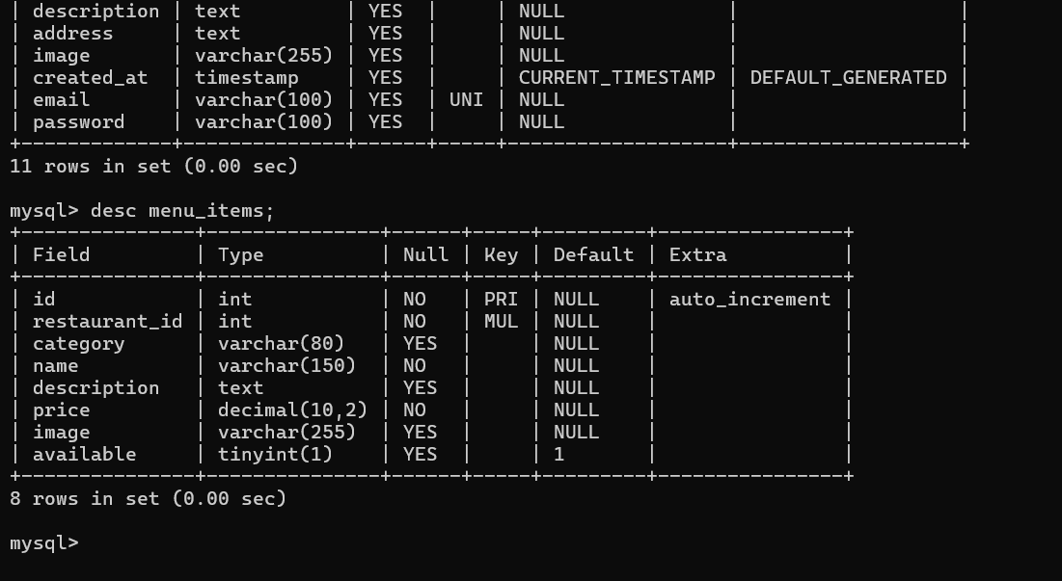

Slide 23


References & Resources
Oracle SQL*Plus User's Guide and Reference – Official Oracle Documentation for database implementation standards
Connolly, T., & Begg, C. (2015). Database Systems: A Practical Approach to Design, Implementation, and Management. Pearson Education
Academic Research Papers on advanced database management techniques and PL/SQL automation in transactional systems
Industry Case Studies analyzing backend database models of leading platforms like Swiggy, Zomato, and Uber Eats
This project demonstrates practical application of database design principles learned in coursework, bridging theoretical knowledge with real-world implementation challenges.

